Slide 1


HOSPITAL DATABASE MANAGEMENT SYSTEM
RNS INSTITUTE OF TECHNOLOGY
BENGALURU - 98
DEPARTMENT OF INFORMATION SCIENCE & ENGINEERING
DBMS MINI PROJECT SEMINAR
By
Manikanta YA Kalpaj Pise
1RN17IS052 1RN17IS039
Under the guidance of
FACULTY INCHARGE LAB INCHARGE
Mr. Ramesh C Mrs. Kusuma S
Assistant Professor, Assistant Professor,
Department of ISE, RNSIT

Slide 2
AGENDA
Abstract
Introduction
Front end and Back end tools
ER-Diagram
Schema Diagram
Tables description with Normalization
Stored Procedures and Triggers
Snapshots
Conclusion
References
Department of ISE, RNSIT

Slide 3
ABSTRACT
The purpose of the project entitled as “HOSPITAL MANAGEMENT SYSTEM” is to computerize the Front Office Management of Hospital to develop software which is user friendly simple, fast, and cost – effective. It deals with the collection of patient’s information, diagnosis details, etc. Traditionally, it was done manually.
The main function of the system is register and store patient details and doctor details and retrieve these details as and when required, and also to manipulate these details meaningfully System input contains patient details, diagnosis details, while system output is to get these details on to the screen. The Hospital Management System can be entered using a username and password. It is accessible either by an administrator or receptionist. Only they can add data into the database. The data can be retrieved easily. The data are well protected for personal use and makes the data processing very fast.
Department of ISE, RNSIT

Slide 4
Introduction
A Database is an organized collection of data, generally stored and accessed electronically from a computer system. Where databases are more complex, they are often developed using formal design and modeling techniques.
The database management system (DBMS) is the software that interacts with end users, applications, the database itself to capture and analyze the data and provides facilities to administer the database.
The DBMS manages three important things: the data, the database engine that allows data to be accessed, locked and modified and the database schema, which defines the database’s logical structure. These three foundational elements help provide concurrency, security, data integrity and uniform administration procedures.
Department of ISE, RNSIT

Slide 5
Introduction Contd.
Department of ISE, RNSIT

Slide 6
Font end and Back end tools
HTML:
HTML or ”Hypertext Markup Language” is the standard markup language used to create web pages.
CSS:
  CSS or “Cascading Style Sheet is a style sheet language used for describing the look and formatting of a document written in a markup language.
PHP:
PHP or “Hypertext Preprocessor” is a general-purpose programming language originally designed for web development.
MySQL:
MySQL is developed, distributed, and supported by Oracle Corporation. MySQL is a database system used on the web it runs on a server
Department of ISE, RNSIT

Slide 7
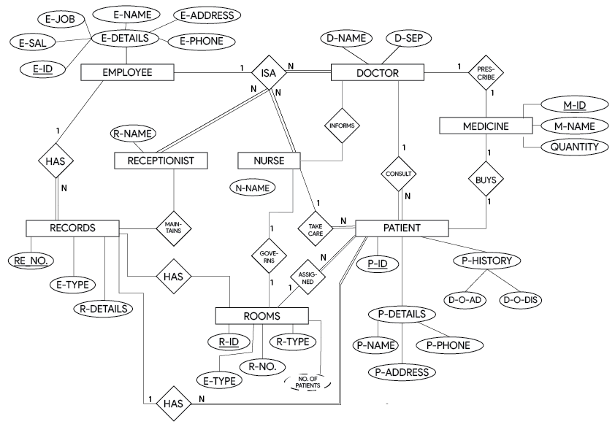
ER-Diagram
Department of ISE, RNSIT

Slide 8
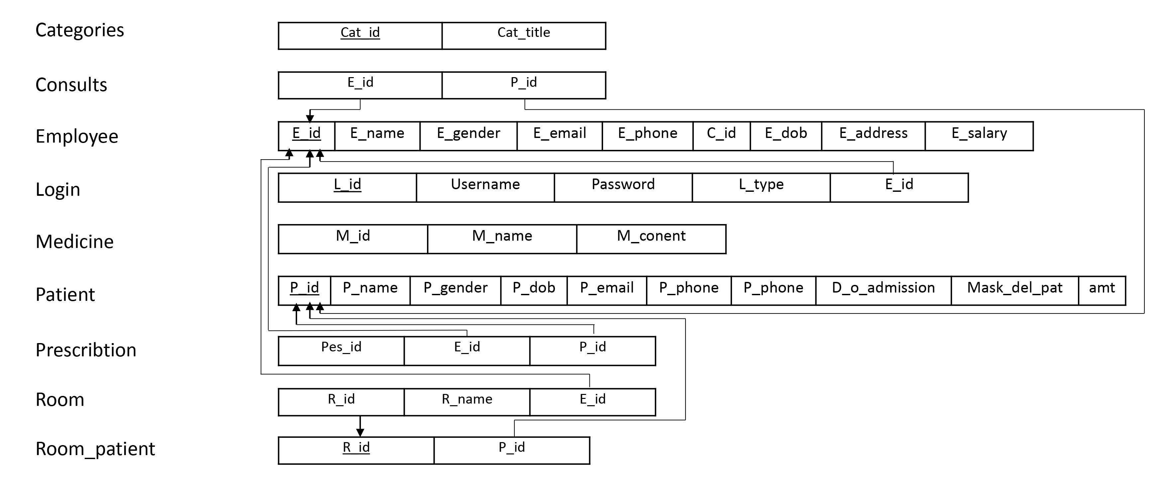
Schema Diagram
Department of ISE, RNSIT

Slide 9
Table Description
CATEGORIES:
It consists of categories of Employee according to their job and occupation(works).
CONSULTS:
As the cardinality ratio of Employee and Patients are M: N, The CONSULTS table consists of details of Patients (P_id) consulting to a Doctor (E_id).
EMPLOYEE: I
t is a table that consists of details of Employee (Personal Details). The table consist of name, id, salary, gender, phone number, date of birth, address, etc.
LOGIN:
This table consists details of all the user data. where we have attributes as username name for unique identity and password which protects the details of the Employee where the particular user can access their authority.
Department of ISE, RNSIT

Slide 10
Table Description Contd.
MEDICINE:
This table consist of details of medicine which are used for the treatment of the Patient. This table has unique Medicine ID, name, contains of medicine.
PATIENT:
It is a table that consists of details of Patient (Personal Details). The table consist of name, id, gender, phone number, date of birth, address, etc.
PRESCRIBTION:
It consists Id of Employee and Patient with the unique prescription Id to prescribe Medicine to that Patient.
PRESCRIBE:
The Doctor prescribe the medicine for a particular Patient that details where for a respective prescription Id, Doctor prescribe N Medicine for that Patient.
Department of ISE, RNSIT

Slide 11
Table Description Contd.
ROOM:
It consists details of the Rooms that are present in the Organization with the Room unique identification number and Room incharge.
ROOM_PATIENT:
This table keeps the record of the Patient that are admitted in their respective Room as an attribute of P_Id and R_Id.
Department of ISE, RNSIT

Slide 12
Stored Procedure
STORED PROCEDURES:
Various stored procedures are used to insert values into the tables, print the tuples of various tables, delete tuples etc.
CREATE PROCEDURE no_of_patient
AS
SELECT COUNT(DISTINCT(E_ID))
FROM room_patient
GROUP BY r_id
GO;
EXEC no_of_patient;
Department of ISE, RNSIT

Slide 13
Trigger
TRIGGER:
A trigger is a stored procedure in database which automatically invokes whenever a special event in the database occurs
CREATE TRIGGER prescription_id
BEFORE INSERT ON PATIENT
FOR EACH ROW
SET e_id = NEW.e_id;
Department of ISE, RNSIT

Slide 14
Snapshot
Department of ISE, RNSIT

Slide 15
Conclusion
Since we are entering details of the patients electronically in the” Hospital Management System”, data will be secured.
Using this application, we can retrieve patient’s history with a single click.
It easily reduces the book keeping task and thus reduces the human effort and increases accuracy speed.
Future Enhancement :
Chatbot Interface.
Increase the communication between Doctor and Patient by Virtual Interface.
Department of ISE, RNSIT

Slide 16
References
TEXT BOOK :
  Michael .J. Folk, Bill Zoellick, Greg Riccardi: File Structures-An Object Oriented Approach with C++, 3rd Edition, Pearson Education, 1998.
  Silberschatz Korth and Sudharshan, Database System Concepts, 6th Edition, McGrawHill, 2013.
WEBSITES REFERRED
  www.geeksforgeeks.com
  www.codebind.com
  www.includehelp.com
Department of ISE, RNSIT

